Slide 1

Command Line & Version Control
Intro to Computer Science
Spring 2019

Slide 2
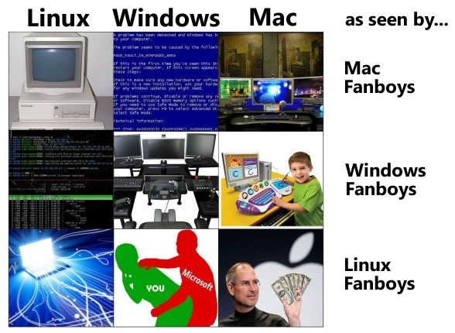
Operating Systems
Windows
VS
Mac
VS
Linux

Slide 3



Unix
Command based
Originally designed for servers
Closed source
Expensive

Slide 4




Linux

Slide 5

Desktop vs Server

Slide 6
Desktop vs Server
Desktop | Server
User friendly Comes with everything you MIGHT need and some stuff you don’t Can be used for any purpose Portability Modularity | Always on Accessible over the internet or a private network Comes ONLY with things you absolutely need for basic functionality Typically configured for a specific purpose

Slide 7
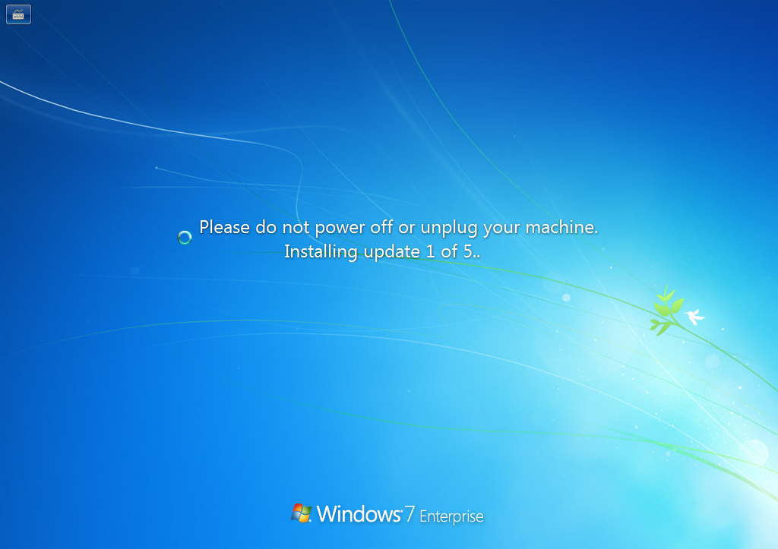

Slide 8
Windows Servers vs Linux Servers
Windows
Restart required for install/uninstall programs
Restart required for updates
Linux
Restart rarely ever required for updates/installing/uninstalling programs
Ability to start/stop/restart services
Greater stability and security
Price (FREE)

Slide 9
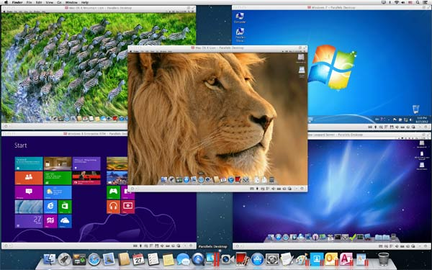
Virtual Machines
Flexibility
OS specific tools or features
Safety
Cross OS interaction

Slide 10
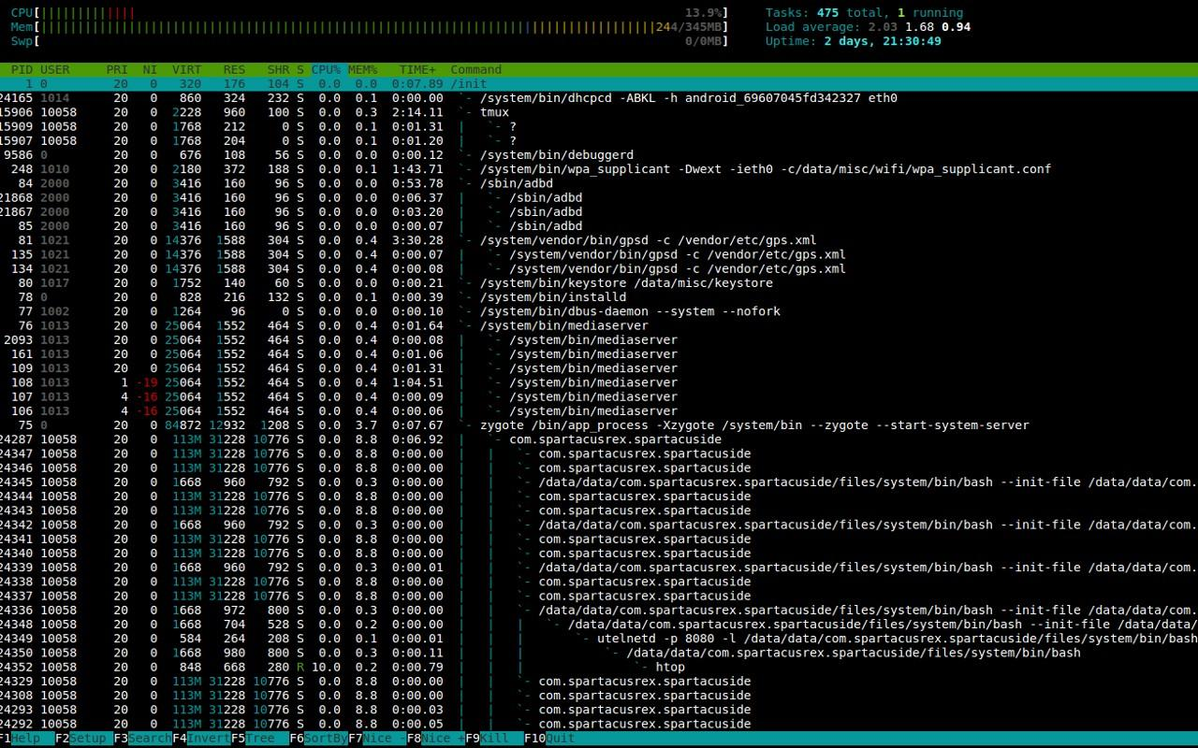
LUI vs GUI

Slide 11
The Command Line
Bourne Again SHell (Bash):
Most commonly supported
Key features: scripting support, closely follows POSIX standards
Z Shell (zsh):
Less common
Key features: better tab completion, command corrections, less strict with POSIX

Slide 12
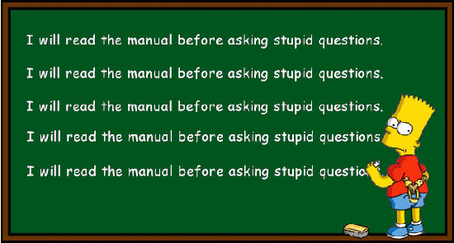
RTFM
Linux has a lot of commands. You will not remember how to use them all.
Luckily, there’s one neat little command that will tell you everything about most (if not all) commands and how to use them.
If there’s one thing command you should never ever forget, it is “man”
How to use it: man <command>

Slide 13
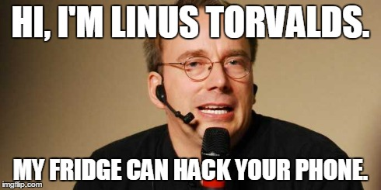
Navigating Linux
man: manual pages for commands or programs
ls: list contents of current directory (-a/l/r)
cd: change directory
mkdir: create a new directory
cp: copy (-R)
mv: move or rename (-R)
rm: delete (-R/f)
pwd: print current working directory

Slide 14

The Wildcard Operator
You can perform operations on one or more files or directories using *
The * operator can be used in many ways:
<command> foo/* affects all files in directory foo
<command> *.txt affects all files with names ending in “.txt”
<command> img* affects all files with names starting with “img”
<command> *k* affects all files with names containing “k”

Slide 15
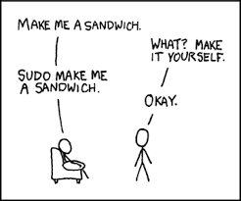
Root and Permissions
Root is the highest level user in a unix/linux system (similar to “Administrator” on Windows)
Most OS’s do not allow users to login as root but can execute operations as root temporarily using “sudo”
Some files and programs can only be accessed by root

Slide 16

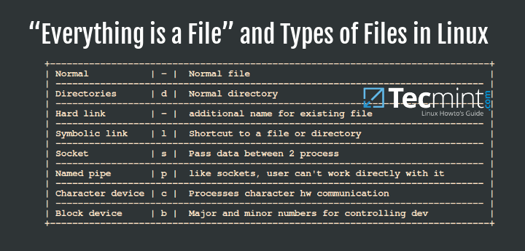
Files

Slide 17
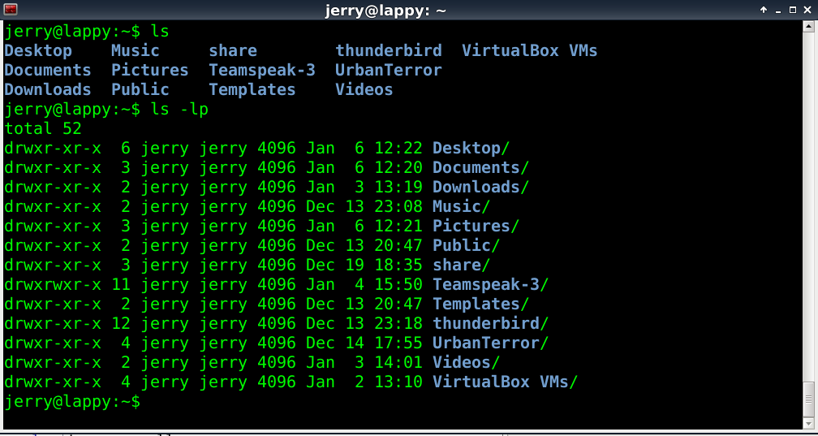
Files (cont)

Slide 18
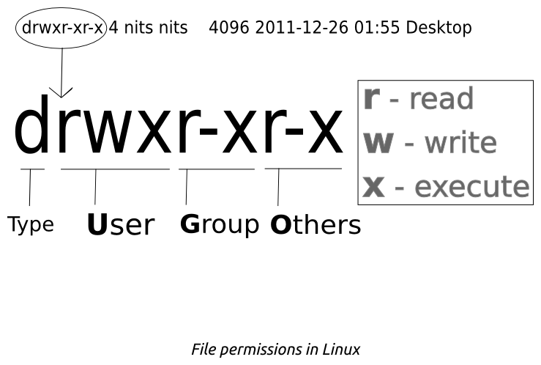

Slide 19
Executable Files (aka programs)
Executable programs must be files that have the execute permission set
Regular files are not executable by default
But you can make a file executable using “chmod +x”
Executables can be run by entering their full or relative path into the shell
Ex: ./program or /full/path/to/program
If the path to the program is stored in the PATH environment variable, it can be run from anywhere by simply entering its name. Ex: python
Find out if a program is in the path using the “which” command

Slide 20
Job Control
Ctrl+c: kill a job in the foreground (quit/cancel)
Ctrl+z: Suspend a job (stop)
ctrl+d: terminate a job
fg: resume a job in the foreground
bg: resume a job in the background
kill: kill a job (background or foreground)
jobs/top: list ongoing jobs or processes

Slide 21
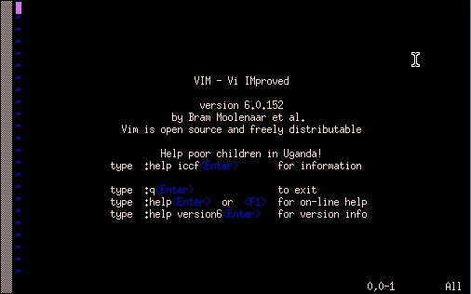
Terminal Text Editors

Slide 22

vim
Vi IMproved Text Editor
Normal mode: lets you manipulate and interact and navigate text file efficiently
Insert mode (i/a): lets you edit text like a normal editor (add/remove)
Exit insert mode using ESC key

Slide 23
vim
Vim commands: execute vim commands from normal mode by typing “:” and then the command
q - quit
w - write
! - force
set number

Slide 24
More vim
Keyboard commands: Keyboard commands can be used to quickly manipulate and navigate the text from normal mode.
w - go to start of next word
e - go to end of current word
b - go to beginning of current word
v - select text
y - copy (yank) selected text
d - cut (also used to delete) selected text
p - paste

Slide 25
Advanced vim
You can go even faster by combining commands and/or numbers
yy - copy an entire line
dd - cut an entire line
ni<text> - inserts <text> n times
nf<letter> - find nth letter
* - find next occurrence of current word
# - find previous occurrence of current word
nG - goto line n
/<text> - search for <text> (n for next occurrence)

Slide 26
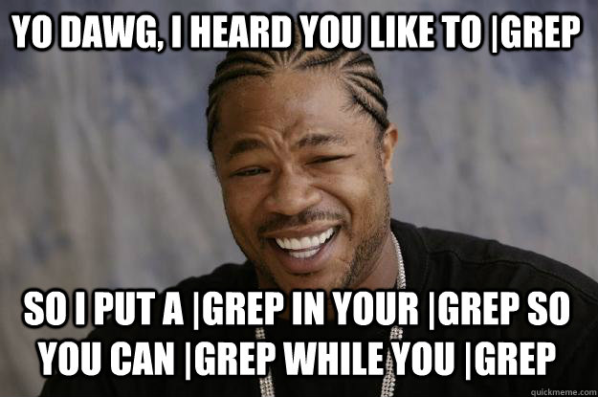
Text programs
cat: prints out contents of a file
echo: prints text to the console
less: lets you scroll through a file
grep: insanely useful pattern matcher
search for a word in text files or file names
supports regular expressions
very useful in combination with pipe “|”

Slide 27
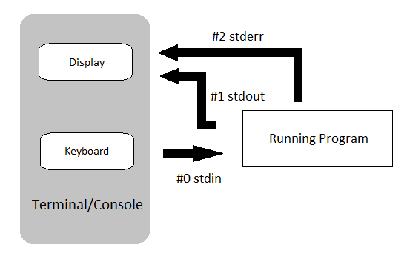
Standard Input/Output (stdio)
Programs can take input from the console (keyboard) and print its output on the console (screen)

Slide 28

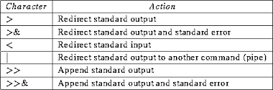
Standard Input/Output (stdio)
By using some special notation we can redirect the output of many commands to files, devices, and even to the input of other commands.

Slide 29

Web tools
wget: download a file from web
curl: data transfer tool that can be used to make http requests (such as GET/POST)
nc: open or connect to a tcp/udp websocket
ssh: remotely connect to another computer

Slide 30

FTP and SCP
File Transfer Protocol
Many of the same commands (ls, cd, mkdir, etc)
connect - connect to a remote ftp server
!<command> - execute as local user
get - download file from remote directory
put - upload file to remote directory
Secure Copy
Another way to quickly transfer files to and from local and remote hosts
scp remoteuser@remotehost:remote/path/file.txt local/directory/

Slide 31
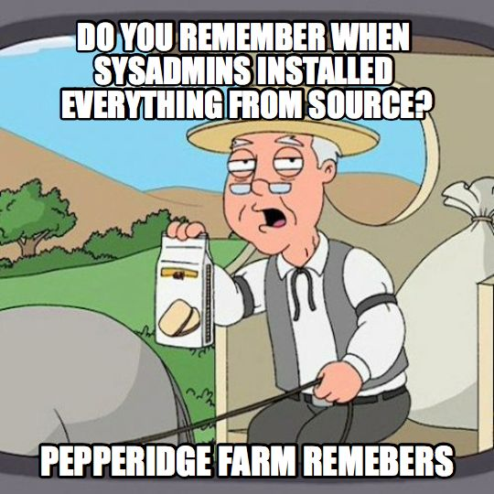
Package Managers
apt (short for aptitude) is the Debian package manager for installing, removing, and updating programs
upgrade: install newest version of all packages
update: resynchronize package indexes
install: install package
remove: uninstall package
search: search package in indexes

Slide 32
Practice!
Bash challenges: http://overthewire.org/wargames/bandit/
Interactive Vim Tutorial: http://www.openvim.com/

Slide 33





Git
Version Control
Consensus
Can be remote or local
Can be centralized or distributed

Slide 34


Version Control
Version 1.0 Version 2.0 Version 2.1 Version 2.2
Original File Cut out all unwanted parts Added transitions Special Effects

Slide 35


Consensus
A project storage system where either the most recent version or the most agreed upon version of the project can exist.
Server’s copy
Alice’s copy
Bob’s copy

Slide 36
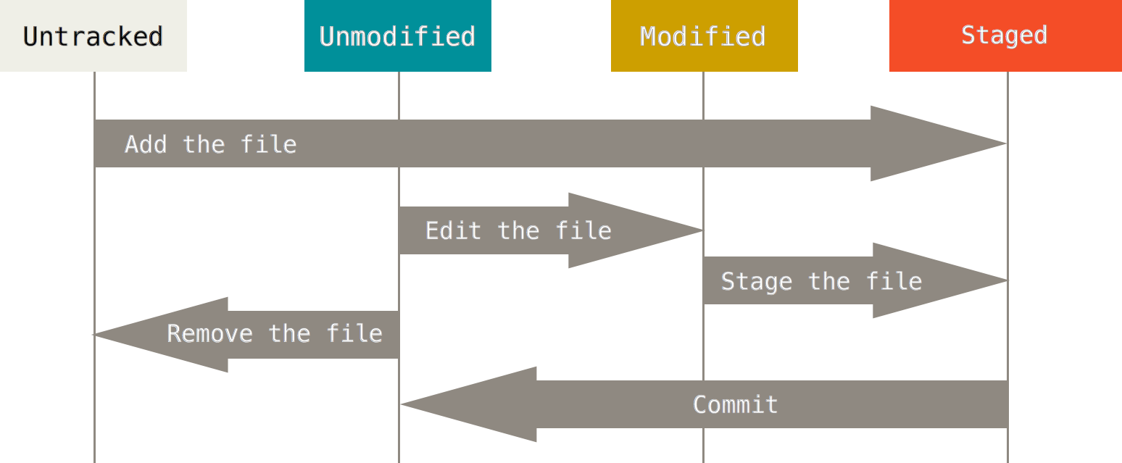
Basic Workflow

Slide 37
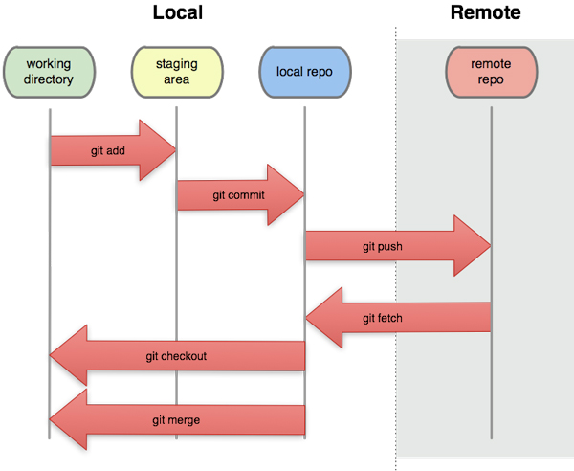
Examples With Git
Most common commands:
clone - download repo
add - stage files
commit - commit files
push - push commits to remote
fetch - updates local repo
branch - create new branch
checkout - change current branch
merge - try to combine changes
pull - fetch and merge

Slide 38
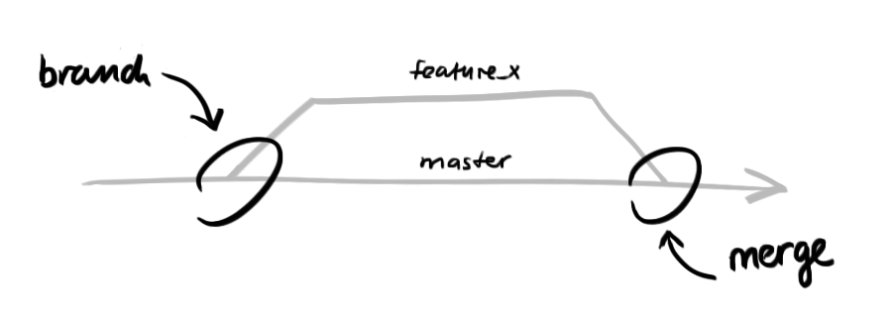
Merge Conflicts
When two developers have worked on the same code.
The system needs to figure out which is the version is correct
There are automatic ways to resolve the conflict, but in many cases it requires manual intervention from one or more of the developers

Slide 39
Let’s push some code!
https://classroom.github.com/a/9RjhTDlZ

